Slide 1
Cyclistic Trip Data Analysis for Trends by Rider Type
Presented by: Ziyi Xu
Last Updated: April 2022

Slide 2
Table of Contents
Project Overview (Goals & Business Tasks)
Data and Analysis
Conclusions & Recommendations
The End / Q&A
Appendix (With Tables)

Slide 3
1.
What are we talking about?
Let’s start with the Project Overview

Slide 4
Project Overview
The Project's Goal
Design new marketing strategies to convert casual riders into annual members for Cyclistic’s future growth.
(Casual riders include riders with single-ride or full-day passes)
Business Task
Determine how annual members and casual riders use Cyclistic bikes differently.
(This is the first of three questions that will guide the future marketing program)

Slide 5
2.
Trip Data and Analysis
Data is analyzed in multiple dimensions, contrasted by rider type.

Slide 6
Data Overview
Cyclistic’s historical trip data of previous 12 months, from Apr 2021 to Mar 2022, is used.
Dataset consists of more than 5 million trips during the 12 months’ time.
Dataset has some limitations and has been cleaned before analysis. Details provided in Appendix.

Slide 7
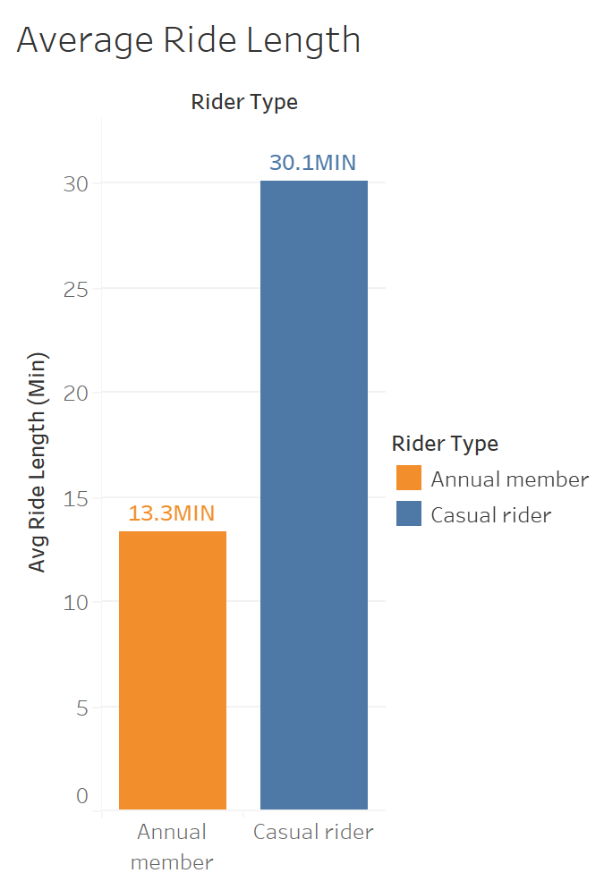
Overall Average Ride Length by Rider Type
Overall average ride length varies largely among annual members and casual riders.
On average, annual member generally takes only half of the time than casual riders in rides.
The average ride length by annual members is 13.3 minutes.
The average ride length by casual riders is 30.1 minutes.

Slide 8
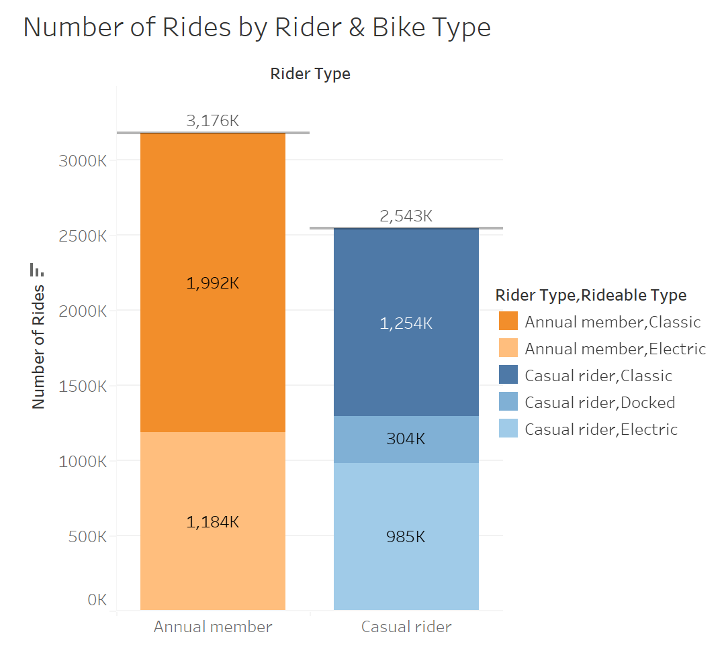
Number of Rides by Bike and Rider Type
The overall number of rides queried is 5.72 million.
Among these, 3.18 million rides are annual members trips, and 2.54 million rides are casual rider trips.
While the rider number of each type is not disclosed, more rides are conducted by annual members than casual riders.
(More on the next slide…)

Slide 9
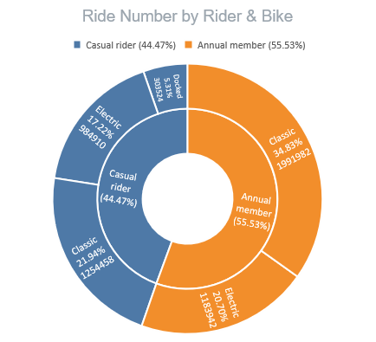
Number of Rides by Bike and Rider Type
(Recap) The overall number of rides - 5.72 million. Annual members trips – 3.18 million Casual rider trips - 2.54 million
Generally the proportion of rides of each bike type resembles in two rider types.
More Classic bikes are ridden than Electric bikes, both for annual members and casual riders.

Slide 10
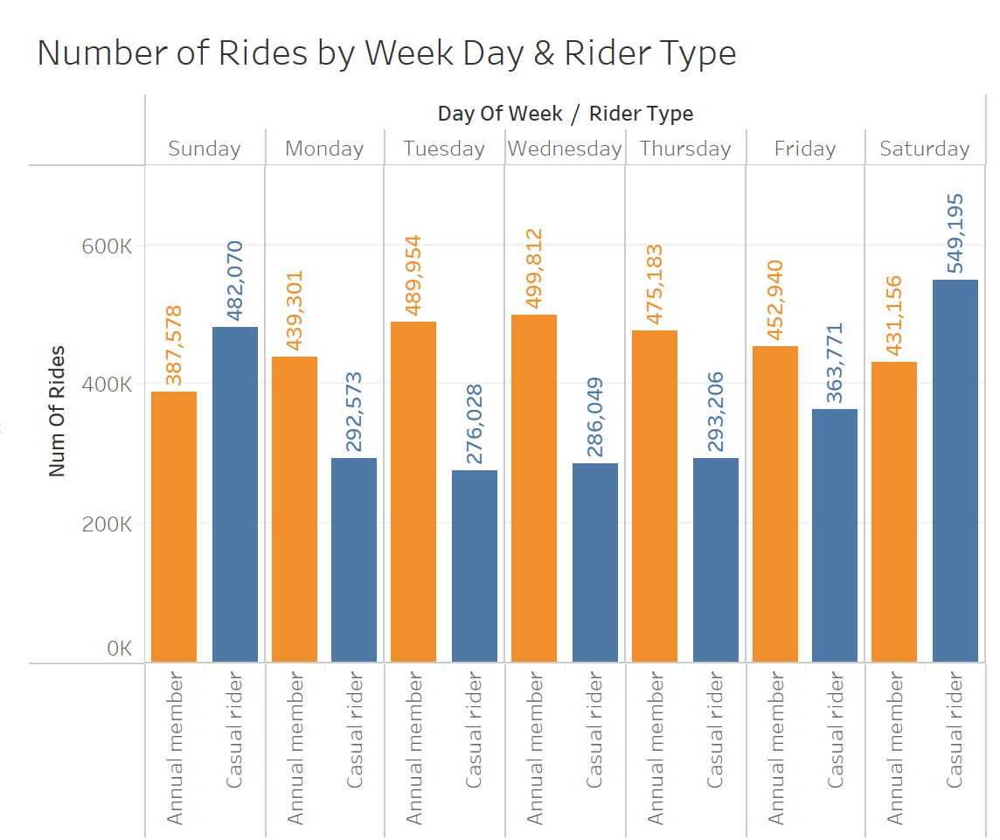
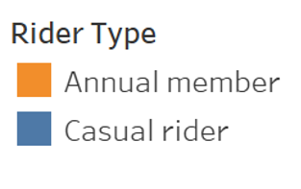
Number of Rides by Week Day and Rider Type
The trend of rides by week day contrasts between annual members and casual riders.
Annual members has far more rides on workdays than casual riders, especially on the middle of the week.
Number of rides by annual member is relatively stable in general.
Casual riders has more rides on weekends than members, but the number drops quickly on workdays, almost half of the weekend figure.

Slide 11
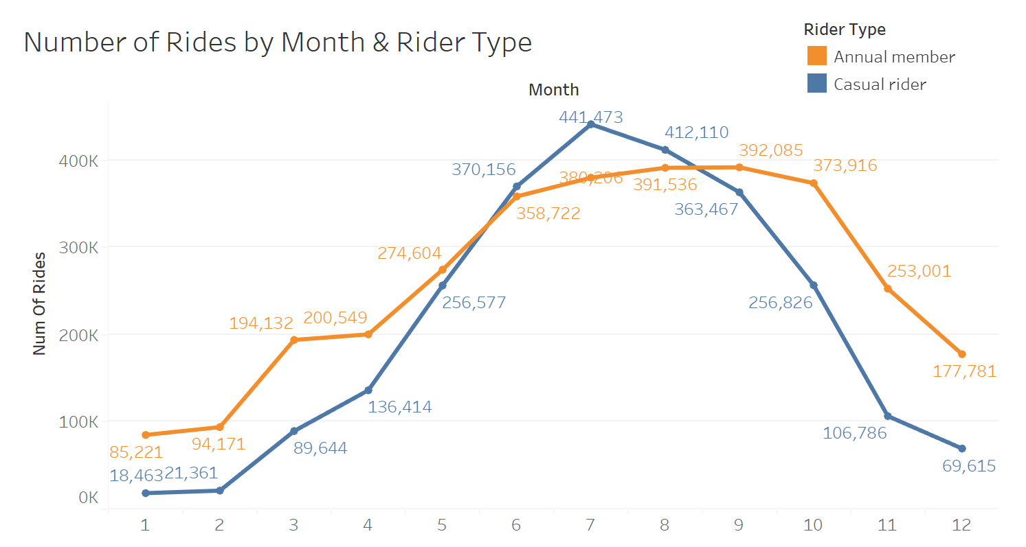
Number of Rides by Month & Rider Type
Number of rides varies greatly, rising on summer and falling on winter.
Although generally there are more rides by members, the number of rides by casual members overtakes on mid-summer (June, July, August).

Slide 12
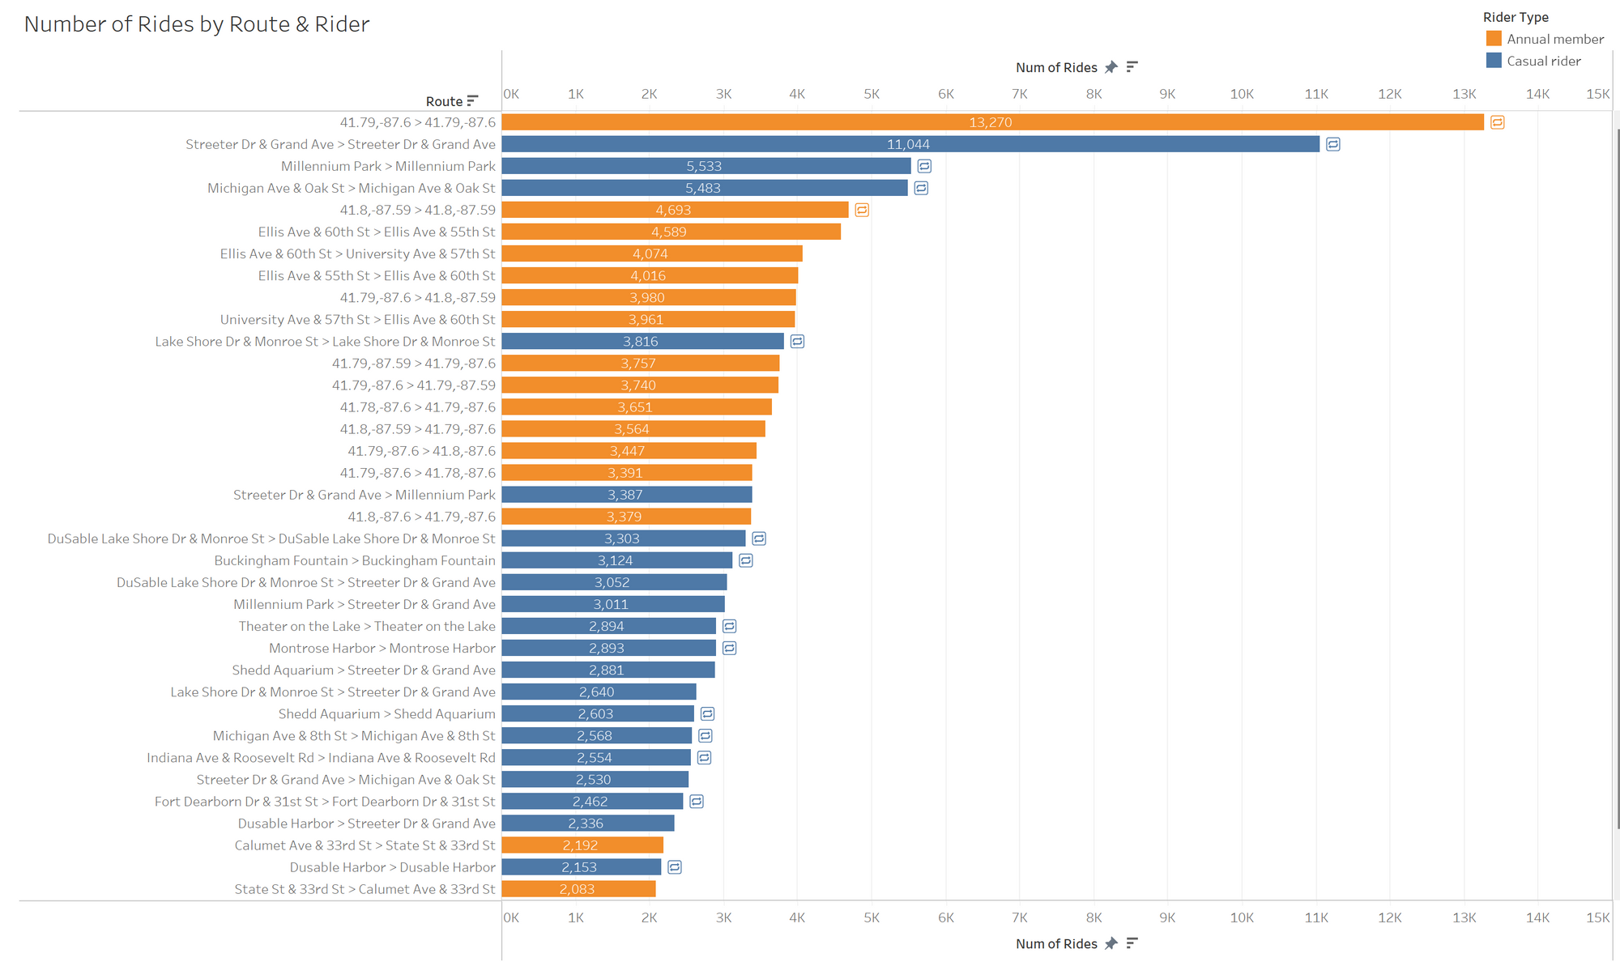
Number of Rides by Route & Rider Type
Frequent routes are grouped and calculated. Non-docked rides are expressed using geo-coordinates. Round rides are also marked at the end of each bar.
Around half of the most frequent routes are round rides, however these frequent routes are generally attributed to casual riders.
The proportion of frequent routes by annual members generally resembles those by casual riders (half-half).
The top two routes are extremely popular, and then the popularity of other routes gradually declines.

Slide 13
3.
Conclusions & Recommendations

Slide 14
Conclusion Key Findings
Compared to casual riders:
Members carried out more rides.
Members tend to have shorter (half-long) rides.
Annual members has far more rides on workdays, but falling behind on weekends. Their usage is quite stable across whole week.
Number of rides by members rises slower from winter to summer and is overtaken on mid-summer (Jun, Jul, Aug).
Few frequent routes by members are round rides, far less then casual riders.

Slide 15
Recommendations Top Three
Design membership advertising strategy for casual riders who have frequent short rides.
Promote a time-limited offer on annual membership on summer weekends for casual riders, or design a special annual membership for weekend rides only.
Implement automatic calculation to convey expected savings through annual memberships to target casual riders mentioned above.

Slide 16
Thanks!
Any questions?
You can also contact me by my email address.

Slide 17
Appendix Data Cleaning & Limitations
Dataset only contains data fields of: incognito ride id, rideable type, start-end date time, start-end station, start-end latitude & longitude, rider type.
Only rides of traditional two-wheeled bikes (3 types) are available. Assistive rides of special bikes like reclining bikes, hand tricycles, and cargo bikes accounts for 8% and are not reflected in the dataset.
Records with NULL end_lat and end_lng values are regarded as invalid and are excluded in the analysis (No null values in start_lat and start_lng).
Records whose ride lengths are negative are discarded in time related analyses. Also, records with ride length less than 1 minute are regarded as potential false starts or redocking and hence excluded in time related analyses as well.

Slide 18
Appendix Queried tables/results
Summary spreadsheet file of the queried tables/results used in the analysis will be supplied here.
[SQL Results - Summary – Charts.xlsx]

